Slide 1

Machine Learning for Cyber Security
Week 12
Mesut GUVEN, Ph.D.

Slide 2
information
Exams; 55% (Mid 25% + Final 30%), Homeworks; 15%, Project; 30%
In homeworks, you will be expected to examine SCI/E papers (published in last 3 years).
In Final Project, you will implement an AI/ML-based cyber solution.
Textbook:
- Getting Started with Deep Learning: Programming and Methodologies using Python
- Hands-On Machine Learning with Scikit-Learn, Keras, and TensorFlow, 2nd Edition
Code: GitHub
Videos: YouTube

Slide 3
UNIT 12: phishing detection
Learning Outcomes;
- to estimate whether a website is a phishing website .

Slide 4
UNIT 12: phishing detection
Phishing is an attack that attempts to steal your money, or your identity, by getting you to reveal personal information -- such as credit card numbers, bank information, or passwords -- on websites that pretend to be legitimate.
Cybercriminals typically pretend to be reputable companies, friends, or acquaintances in a fake message, which contains a link to a phishing website.

Slide 5
UNIT 12: phishing detection
A phishing email/link consist of one or more of these, respectively; Urgent call to action or threats, First time or infrequent senders, Spelling and bad grammar, Generic greetings, Suspicious links or unexpected attachments, Mismatched email domains, etc.
ML models and methods have been using to detect the phishing attacks and mitigate the phishing effects. In the next example the success of ML models on phishing scenario will be presented on the novel phishing dataset.

Slide 6
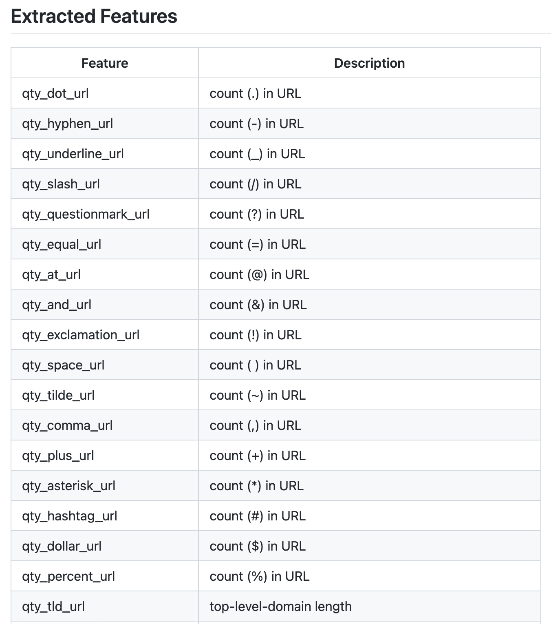
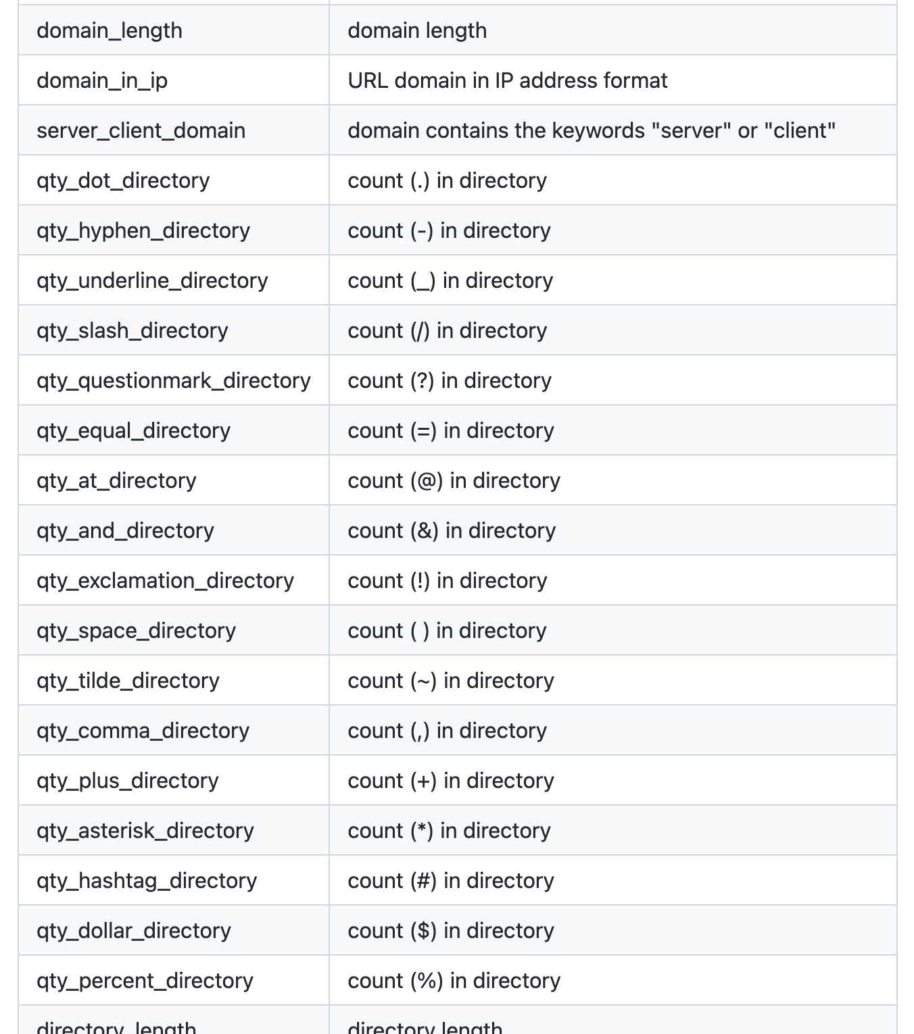
UNIT 12: phishing detection dataset
dataset_full.csv
Short description of the full variant dataset:
Total number of instances: 88,647
Number of legitimate website instances (labeled as 0): 58,000
Number of phishing website instances (labeled as 1): 30,647
Total number of features: 111
dataset_small.csv
Short description of the small variant dataset:
Total number of instances: 58,645
Number of legitimate website instances (labeled as 0): 27,998
Number of phishing website instances (labeled as 1): 30,647
Total number of features: 111

Slide 7
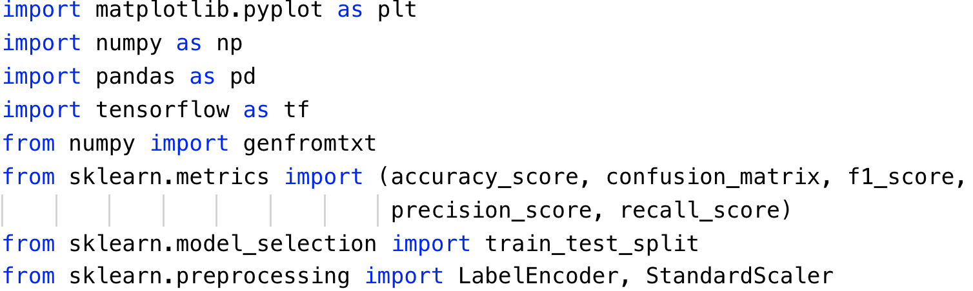
UNIT 12: phishing detection
The dataset contains 102816 web hits, and 30 features were recorded for each of the hit. Also, a class value has been given for each of the record.
Import necessary libraries.

Slide 8
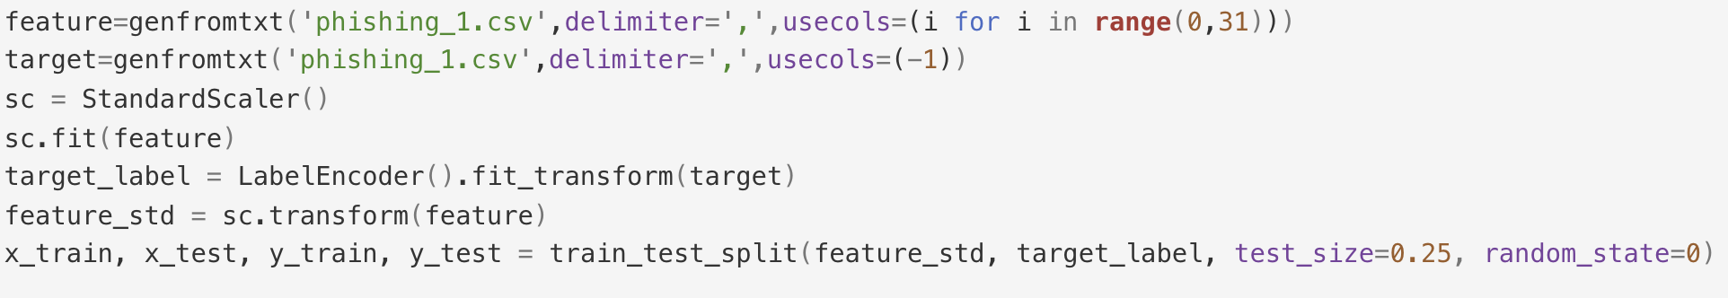
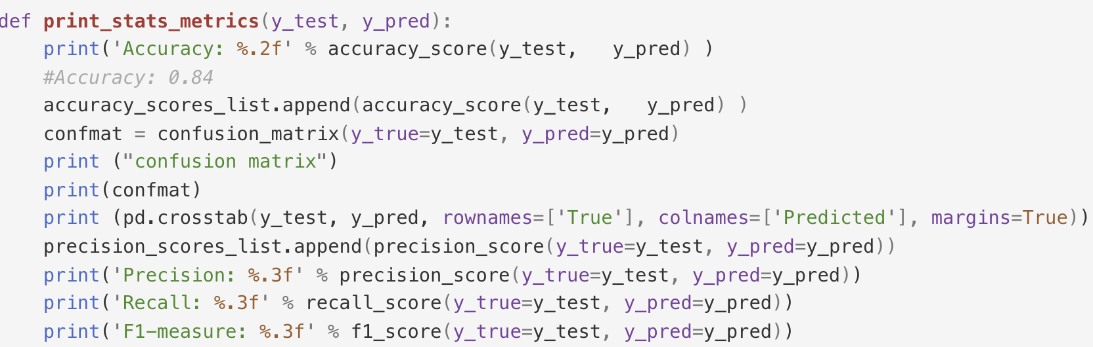
UNIT 12: phishing detection
Read the features and class values from dataset.
Encode the labels for class values, standard scale the feature values and split.

Slide 9
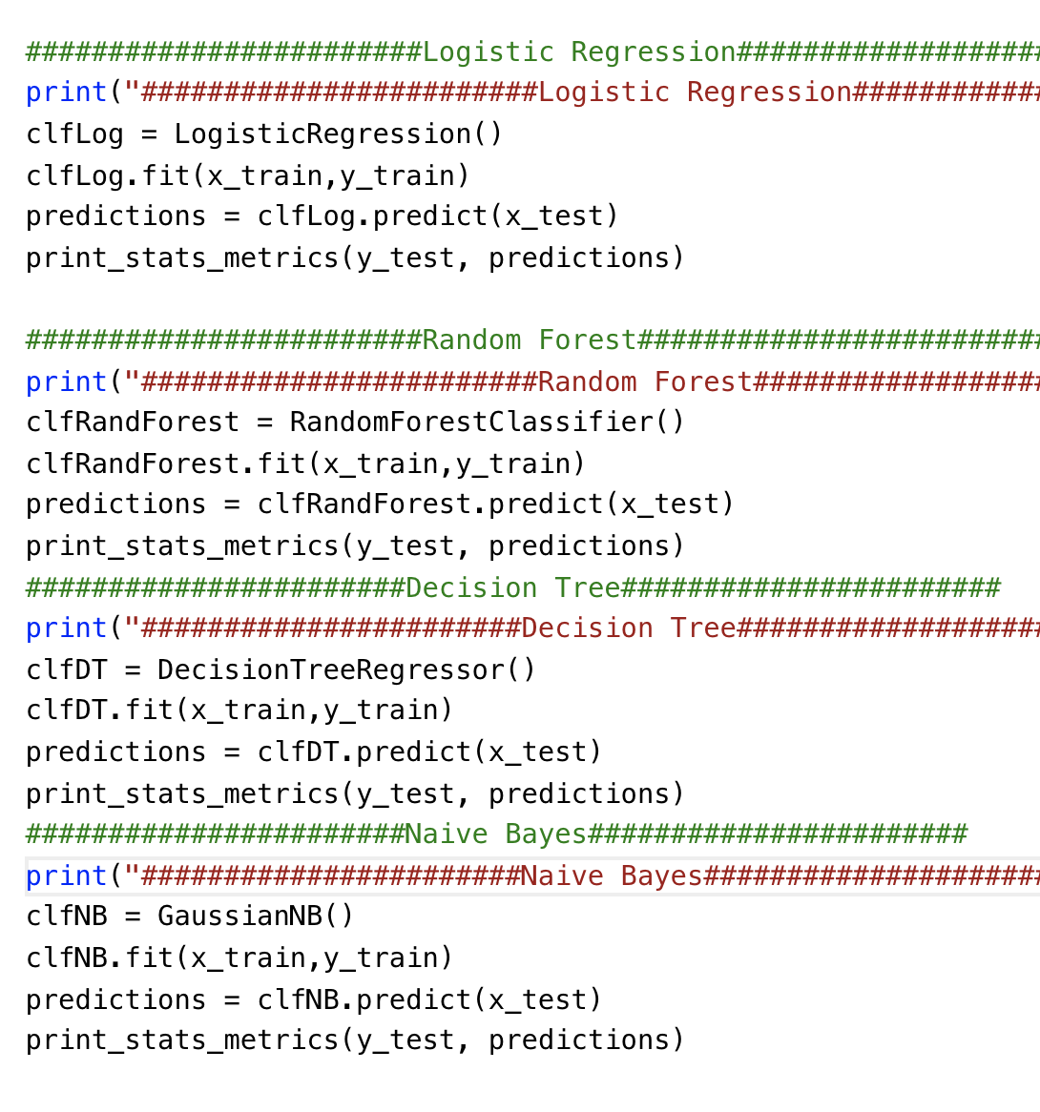
UNIT 12: phishing detection
Specify the type of classifier, then fit it with the training set and perform the prediction with testing set.
Finally, print out the statistics.

Slide 10
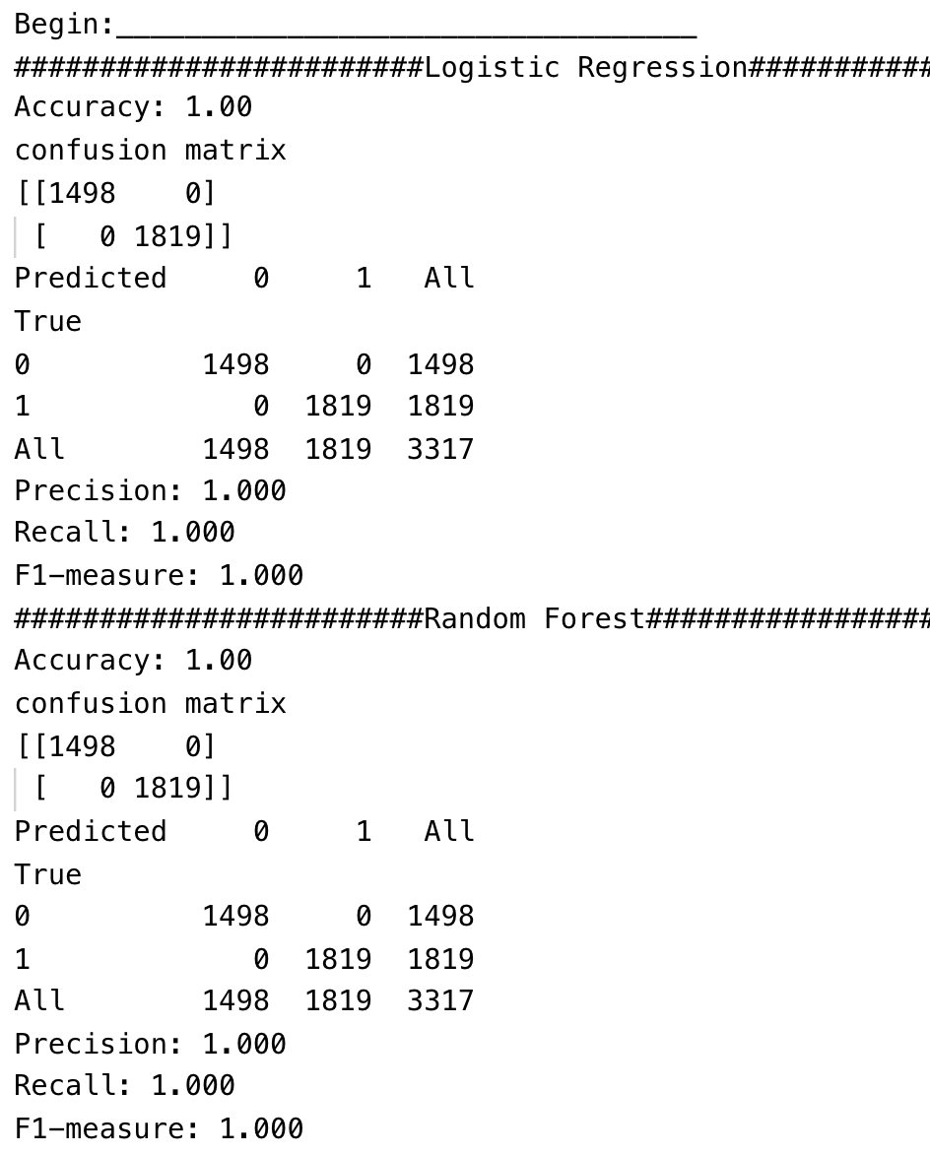
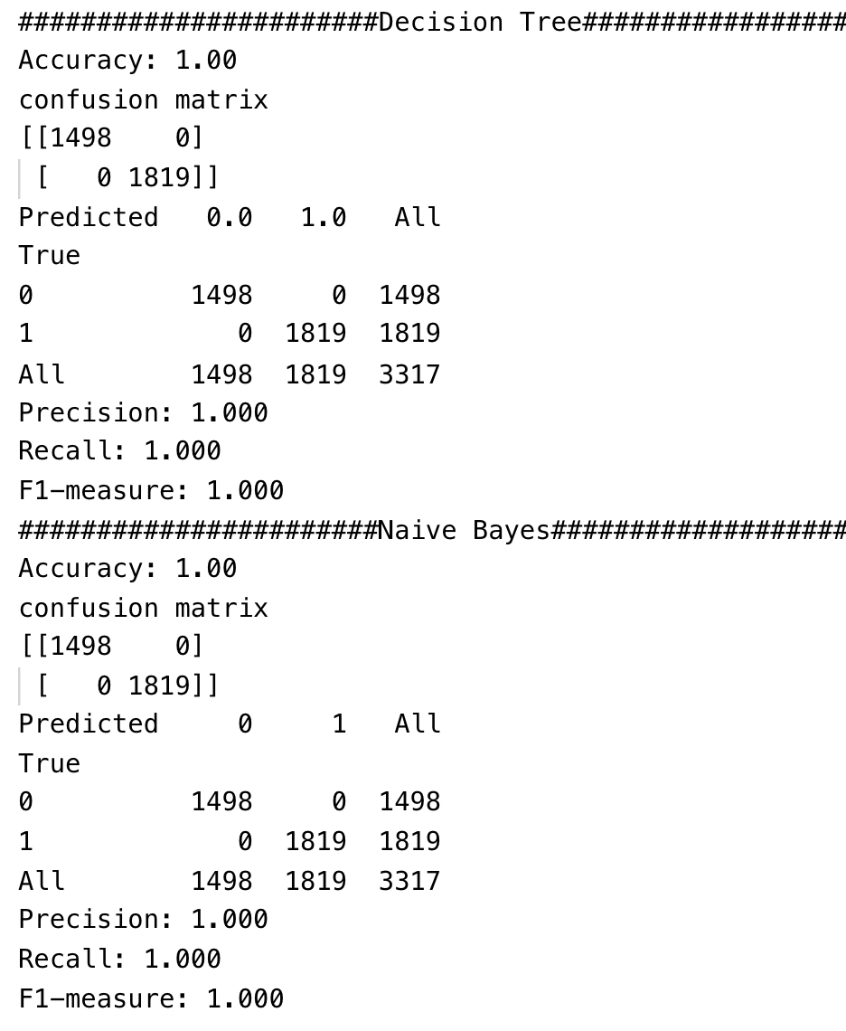
UNIT 12: phishing detection
For computation speed we use a smaller version of the test set.
Traditional ML algorithms perfom very well on the test set.

Slide 11
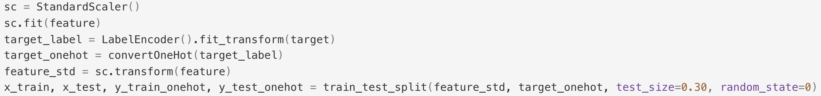
UNIT 12: phishing detection
Import necessary libraries, read the features and class values from dataset.
Encode the labels for class values, standard scale the feature values and split the dataset as well as the one hot encoding for class values.

Slide 12
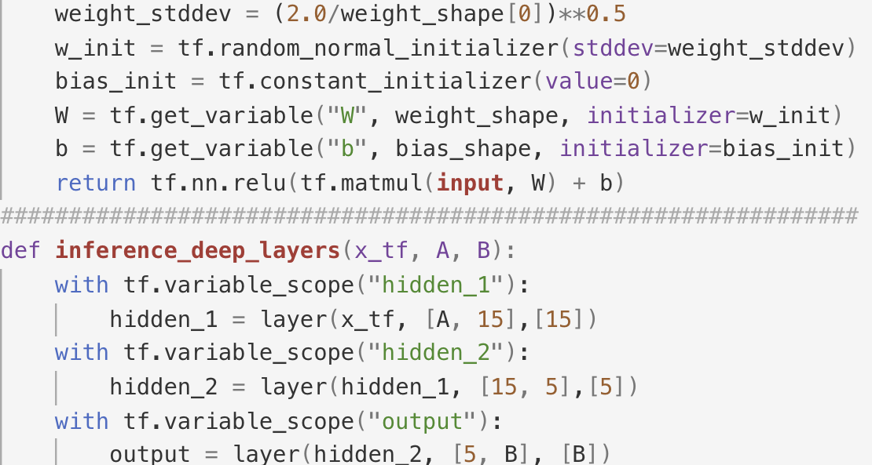
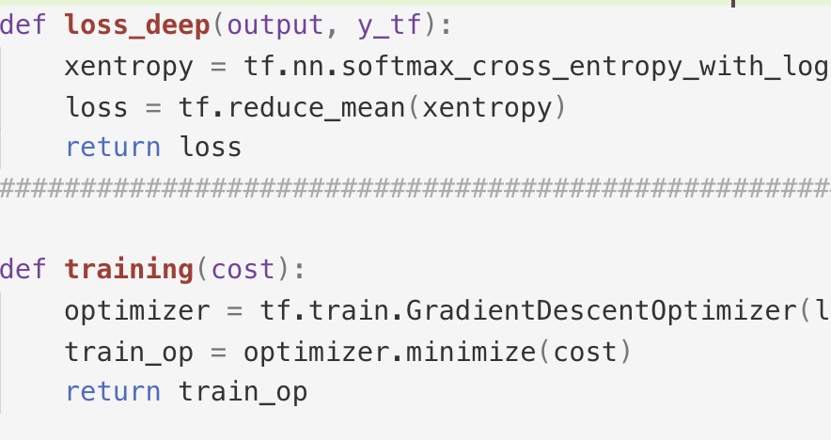
UNIT 12: phishing detection
Define the architecture for deep neural network

Slide 13
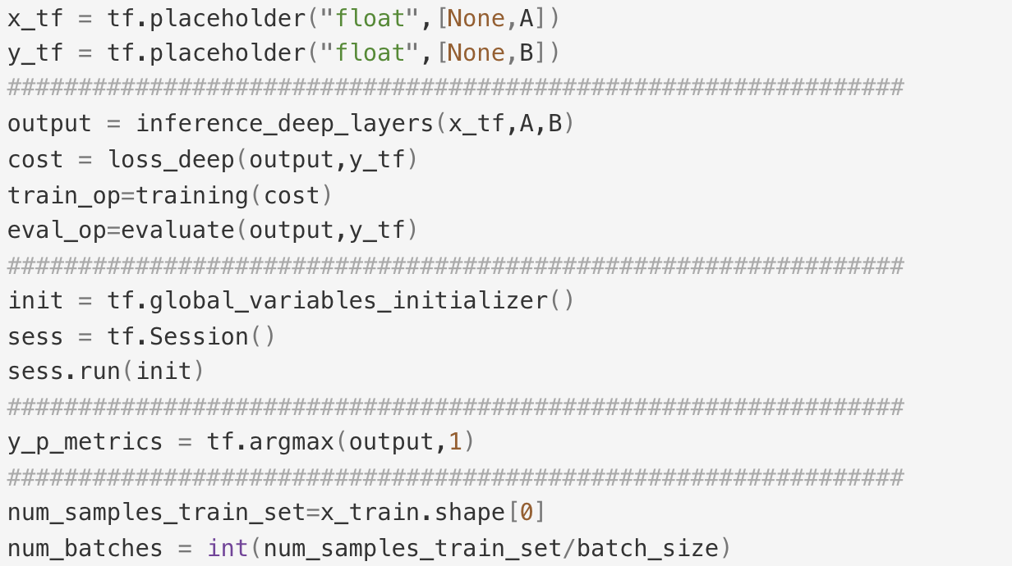
UNIT 12: phishing detection
After running DL model for several epochs, it can reach a ~99 accuracy.

